Slide 1
DinoChicken Project
Dana Rashid
Cell Biology and Neuroscience Department, MSU
Using chicken embryos to understand dinosaur
evolutionary change

Slide 2
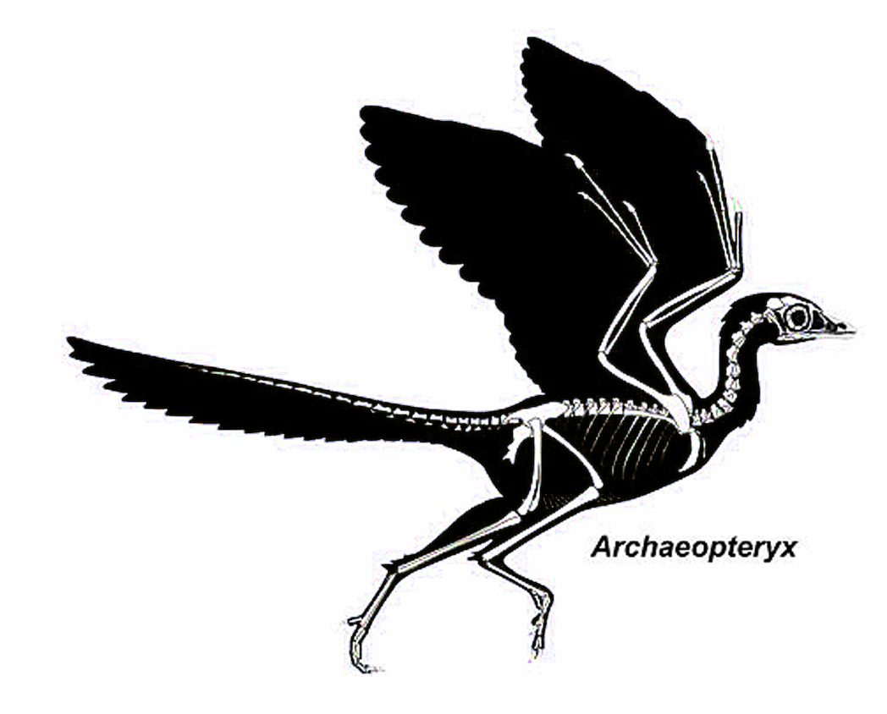
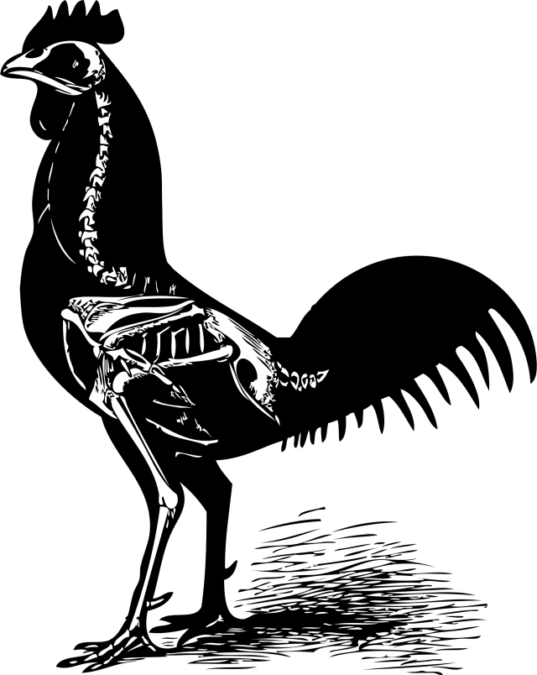
Bird Evolution from Dinosaurs
Chicken
150 million years

Slide 3
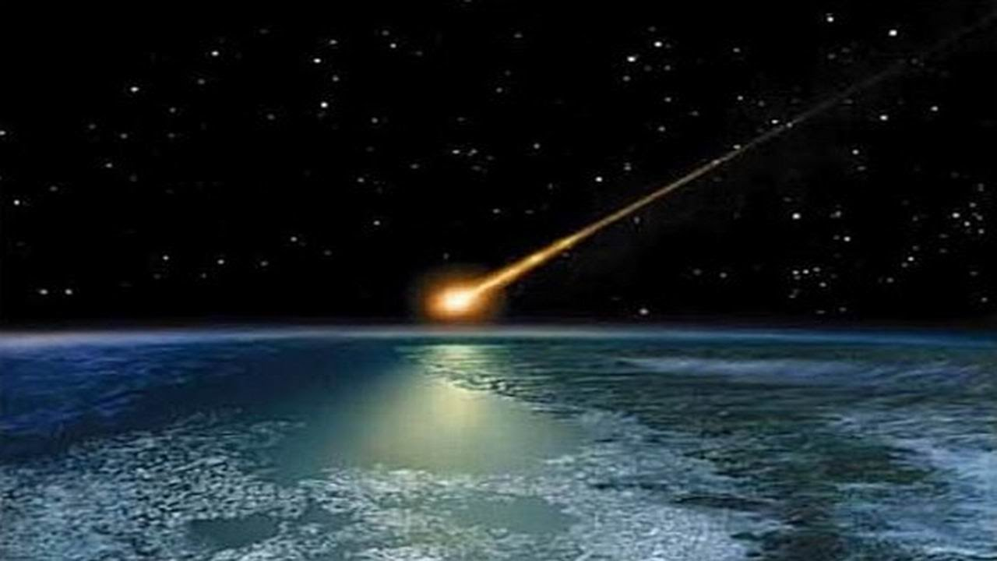
Modern
Birds
(Aves)
K-Pg Extinction Event 66mya
Non-Avian Dinosaurs
Avian Dinosaurs
Theropods
Maniraptorans
Deinonychosauria
Avialae
Oviraptorosauria
Therizinosauria

Slide 4
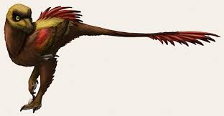
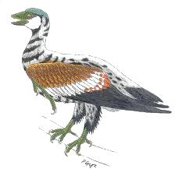
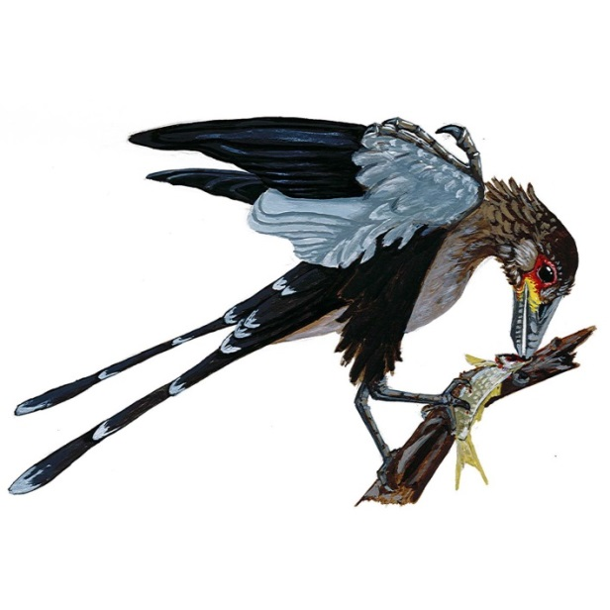
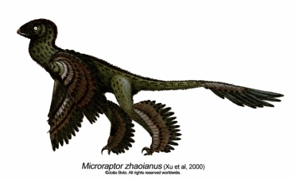
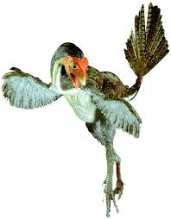
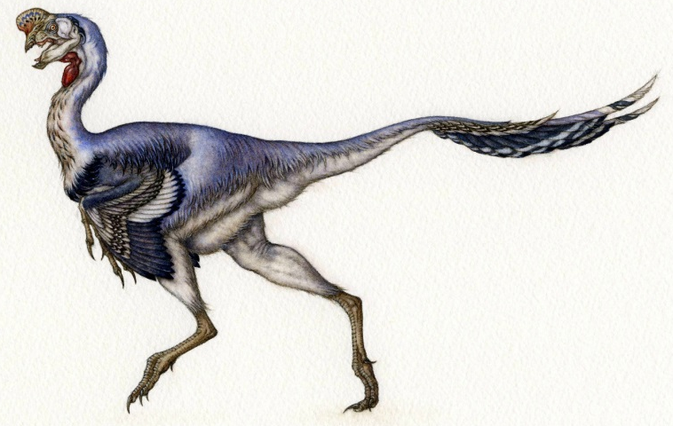
Cretaceous transition to short tails
130-120 mya
Avian dinosaurs
Jeholornis
Sapeornis
Confuciusornis
Non avian dinosaurs
Microraptor
Citipati
Caudipteryx

Slide 5
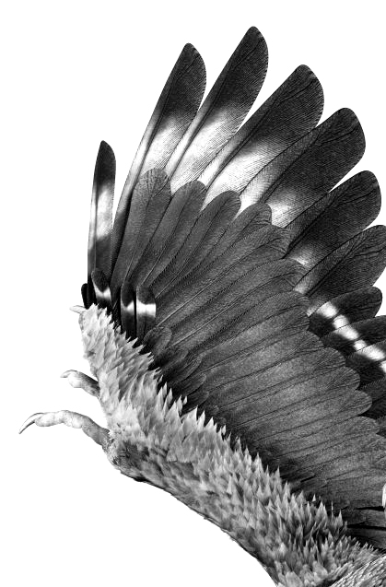
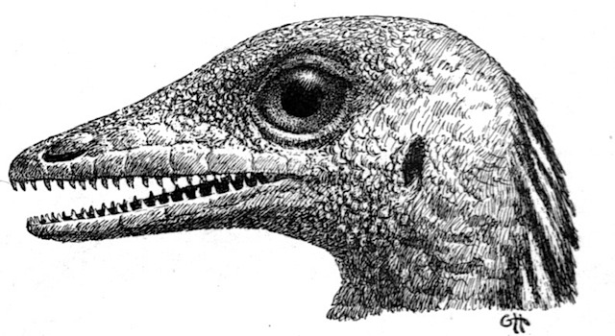
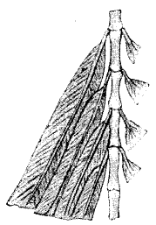
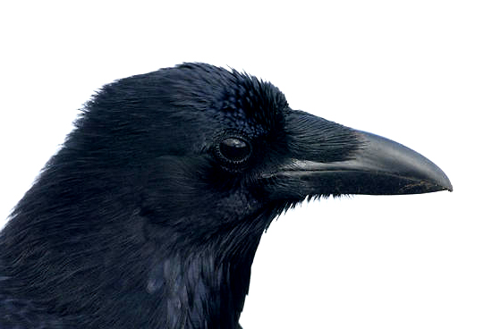
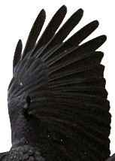
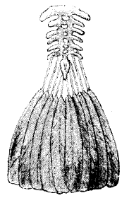
Traits that changed in bird evolution
Long tails to
short tails with a pygostyle
Teeth & Snouts
to beaks
Wings with claws
to without claws
Feather frond to tail feather
fan
Note: Clawed wings are still observed in a few modern birds; teeth disappeared just after the Cretaceous, and tails changed in the Cretaceous.

Slide 6
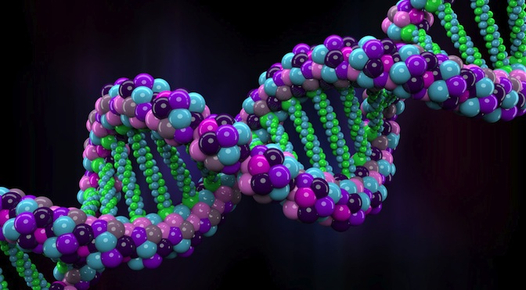
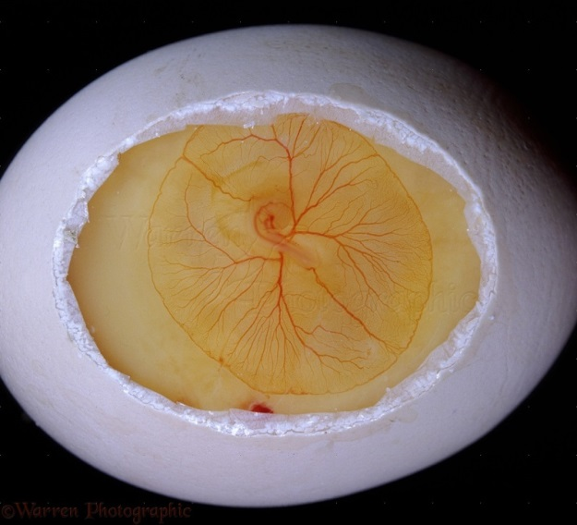
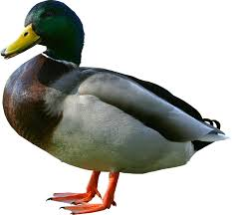
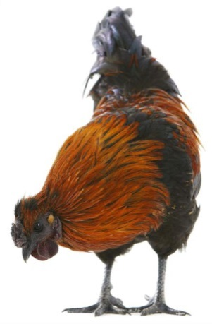
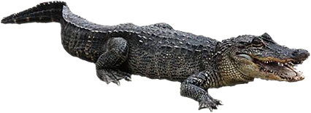
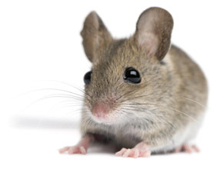
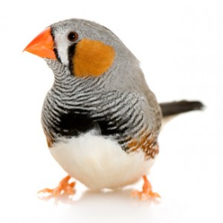
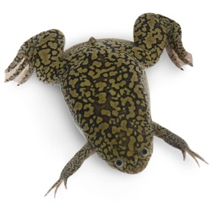
How do we study avian evolutionary events?
Genetics
Development
&
Birds vs. other Vertebrates
Notes:
No DNA from dinosaurs; oldest DNA ever recovered was about 700K years old, from an ancestor of modern horses. It’s unlikely that dino DNA will be sequenced, but I won’t say impossible at this point. If a dino fossil were preserved extraordinarily well, maybe.
By comparing genetics & development between birds and other vertebrates, we can determine which traits are general to vertebrates but specific to birds. We can also look at known mutations, and correlate the effects of those mutations to events in the fossil record.

Slide 7
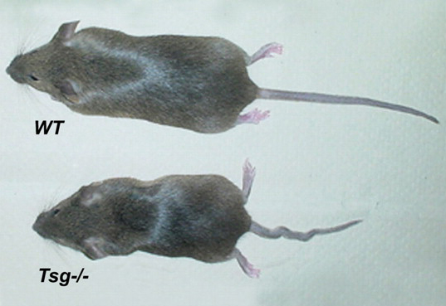
What kinds of mutations in vertebrates cause
short tails and/or fused vertebrae?
Truncated
tail
mutants
Vertebral fusion mutants
So……It’s possible that a single mutation could have both shortened the Cretaceous bird tail and caused the formation of the pygostyle. This possibility is supported by the fossil record.
Notes:
These mutational analyses also told us info on which developmental processes can be affected with short tail/ fused caudal vertebrae mutations. For example, mutations that affect the blood vessels that form in the embryo spinal column can lead to short, fused tails. In this way, we can link genetics to developmental processes.

Slide 8
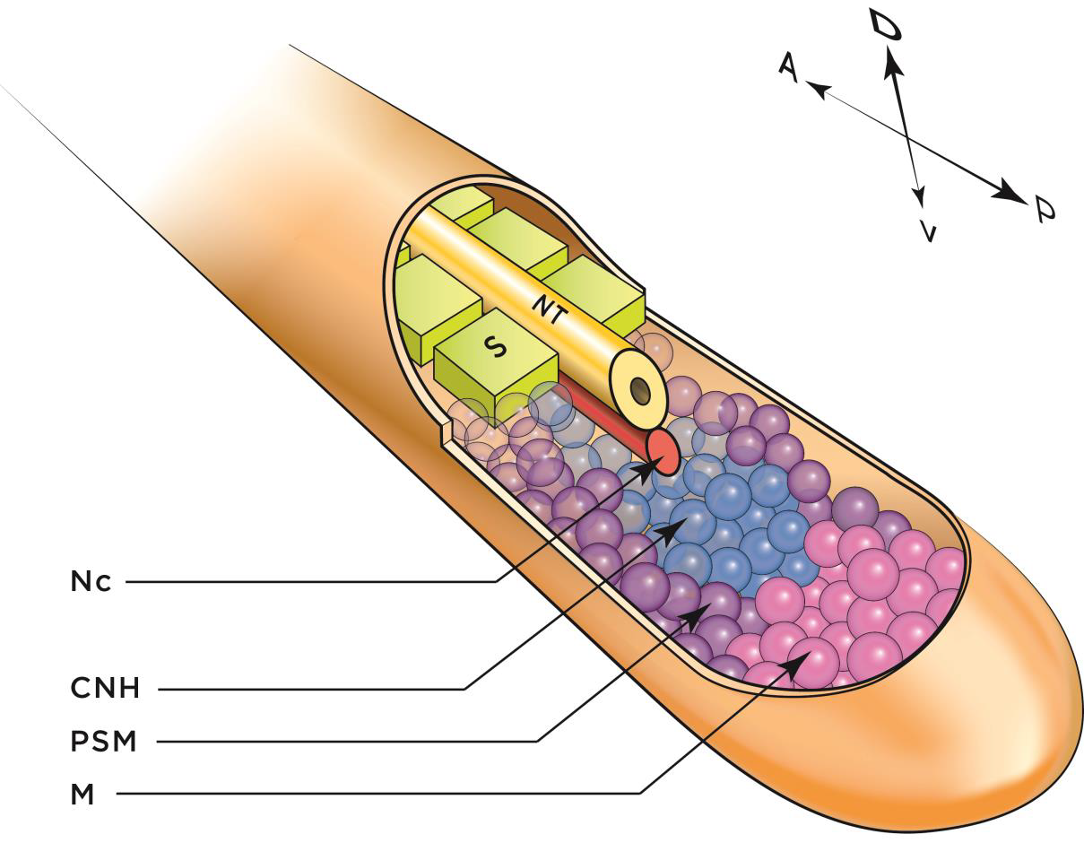
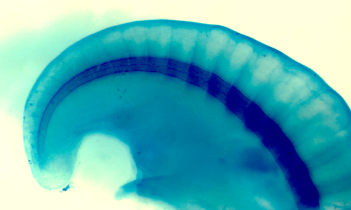
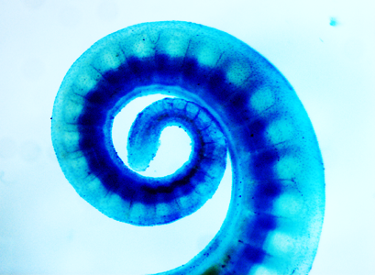
Notes:
We’ve talked about genetics; now I want to delve into development studies. We want to look for clues in chicken embryos for how the bird tail was truncated and distally fused in the Cretaceous. We can compare developmental events between the chicken and say, a long-tailed reptile, like the gecko. Or, we can divvy up the chicken tail into regions, pygostyle and outside pygostyle, and compare those regions to each other. We can examine the development of different structures within the tail. Some of these structures are……

Slide 9
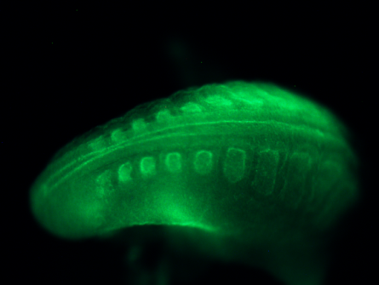
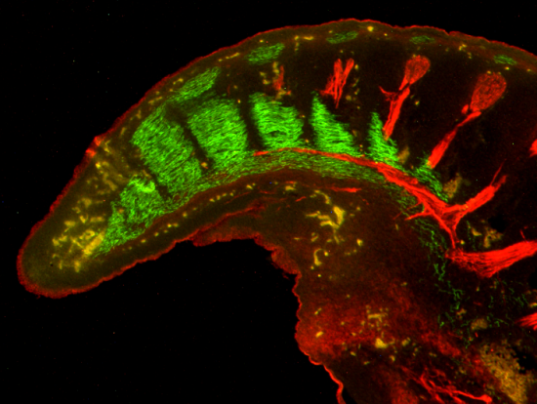
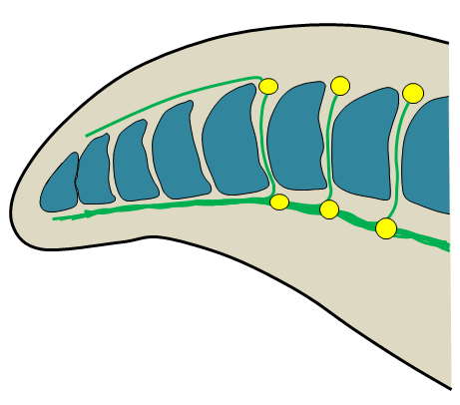
Mutation(s) affecting somite polarity may have been responsible for the Cretaceous transition to short tails
Somites Nervous System
Somite anterior/posterior polarity is not properly established in the chick embryo tail. Mutations like this in mice usually cause loss of spinal nerves and short, fused tails.

Slide 10
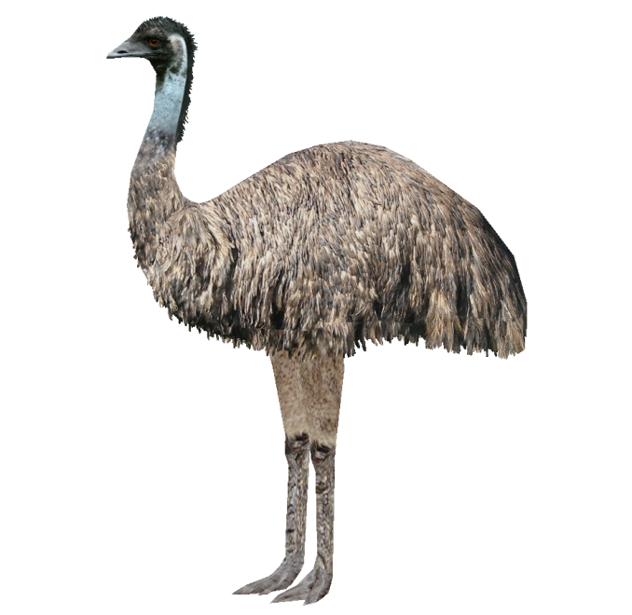
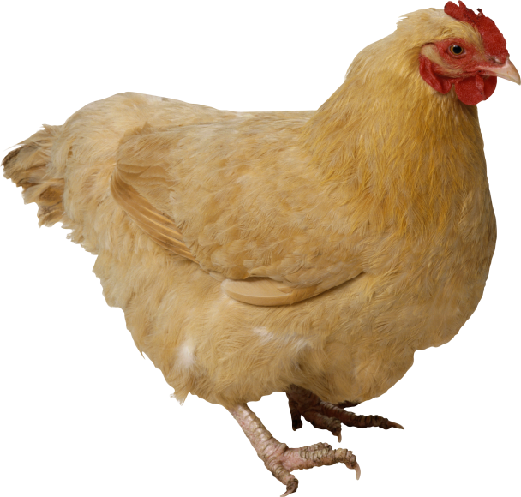
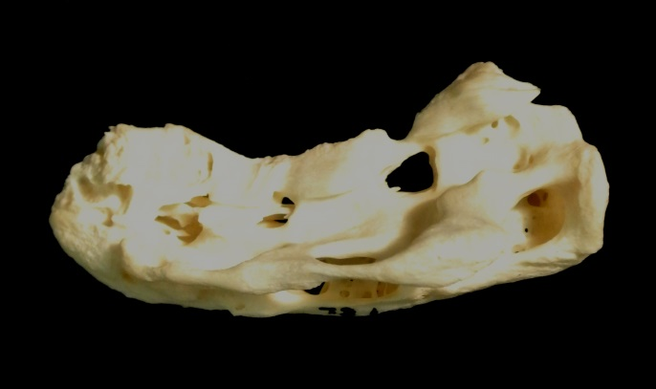
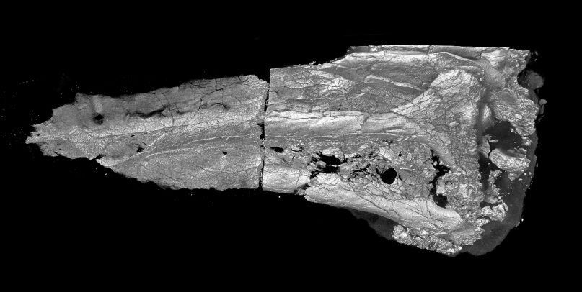
No spinal nerves in the emu

Slide 11
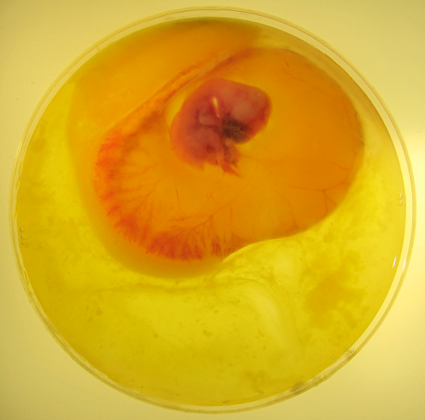
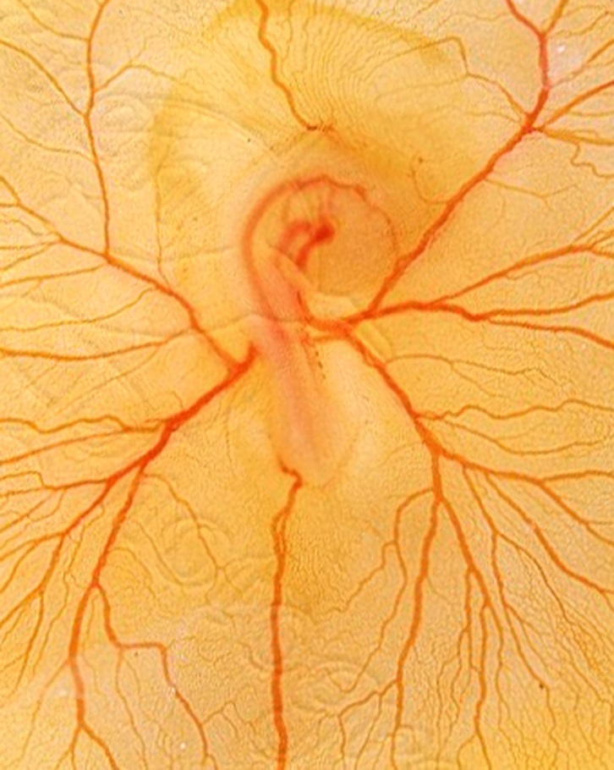
Next up:
Comparative genetics
Embryo manipulations

Slide 12
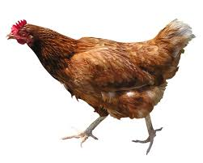
Would any manipulations result in a chicken with
a long tail?
Possibly…
Notes:
We would want to make a chicken with a long tail as a proof of concept. If we can convert, for example, a somite polarity change back to its ancestral condition, would that result in a long ancestral tail? We would want to study many different aspects of this dinochicken, including feather pattern, musculature, and nervous system, as well as changes in gene expression.

Slide 13
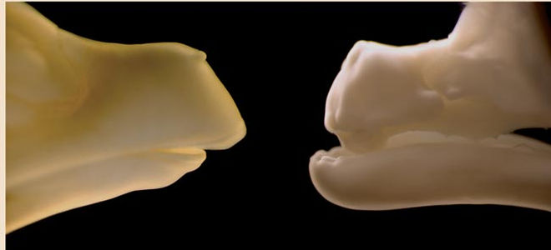
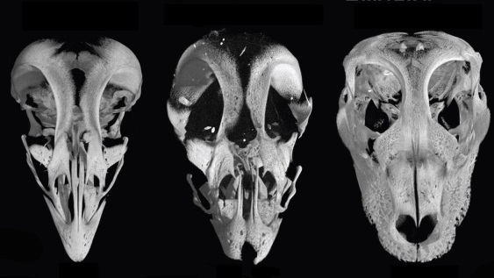
Work from other labs:
A mutant chicken, the talpid chicken, grows teeth.
Harris et al. 2006 Current Biology
By inhibiting a protein at the base of the beak, chicken beaks can resemble dinosaur snouts.
Bhullar et al. 2015 Evolution

Slide 14
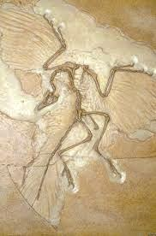
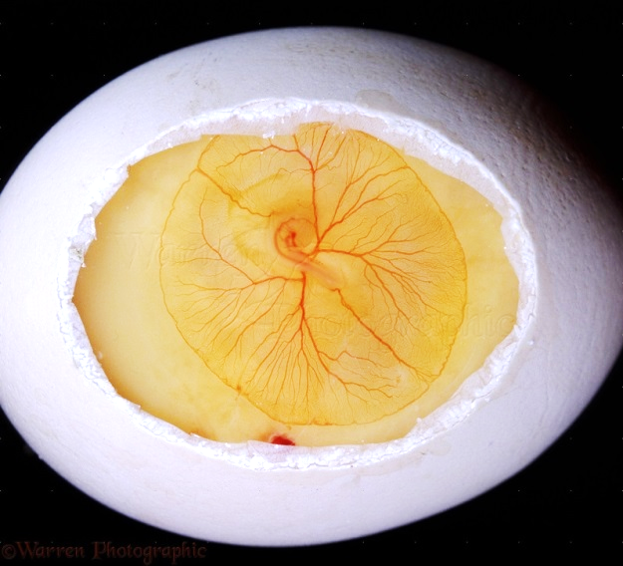
In Summary:
Notes:
If you want to study deep time evolution, you have to start with the fossil record, and identify particular changes in evolutionary history. If you then study genetics, in our case vertebrate mutational analyses, and then examine related develomental processes, you can come a long ways towards understanding how a particular evolutionary event occurred. Even if you don’t figure out exactly how something happened, you can figure how it could have happened, which can be just about as informative.

Slide 15
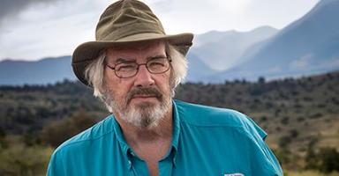
Acknowledgements:
Jack Horner
Collaborators:
Susan Chapman Clemson University
Luis Chiappe LA Museum of NH
Alida Bailleul University of Missouri
Christa Merzdorf Montana State University
Roger Bradley Montana State University
Kevin Surya Montana State University
Funding: George Lucas

