Slide 1
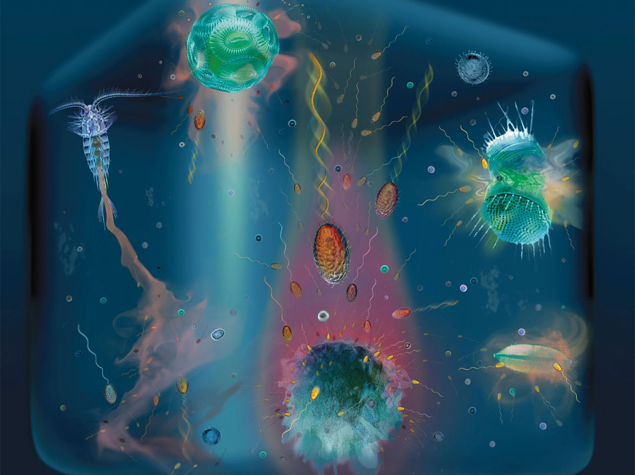
From viruses to microzooplankton: how marine microbes shape ocean biogeochemistry
Dr. Bethanie Edwards
UCMP Geomicrobiology Short Course
February 24, 2018
Notes:
Hi Good Afternoon. My name is Bethanie Edwards I am currently a post-doc at the University of Hawaii. But come this summer I will starting as an associate prof here in the Earth and Planetary Science Department at Berkeley. I am trained as a chemical oceanographer however my work tends to focus more on how marine microbes impact ocean chemistry and in turn global chemical cycles. In fact every second breath you breathe was produced in the ocean by a photosynthesizing microbe. So today I’ll be walking you through how such tiny creatures, marine microbes, can shape ocean biogeochemistry going from the very small viruses to larger zooplankton.

Slide 2
Learning Objectives
Define Biogeochemistry
Understand the Importance of Global Carbon Cycle
Describe the Roles of Marine Microbes in the Oceanic Carbon Cycle (and Connections with Other Elemental Cycles)
  Phytoplankton
  Microzooplankton
  Mesozooplankton
  Heterotrophic Bacteria
  Viruses
Notes:
Just to give you an idea of where this talk is going. I will start by clearing up some of the jargon. What exactly is biogeochemistry? I will introduce the better described global elemental cycles and the idea of a box model. Then we will focus in on the global carbon cycle and why chemical oceanographers like to say “carbon drives the bus’. Then we will get to the real meat of this talk discussing how marine microbes mediate the oceanic carbon cycle and how their activities interact with other elemental cycles as we talk about Phytoplankton, microzooplankton, mesozooplankton, Het. Bact., and viruses.

Slide 3
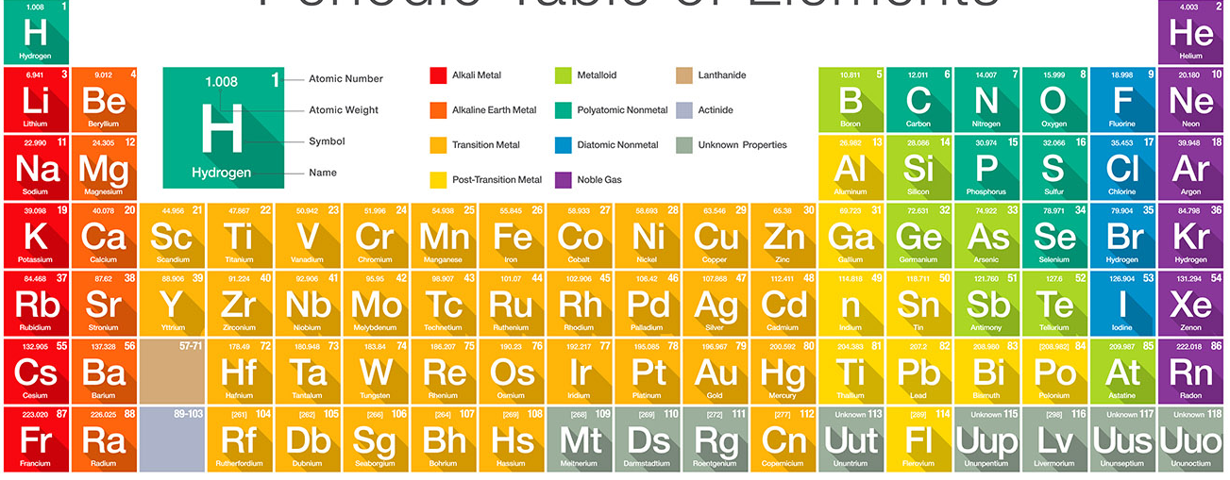
Biogeochemistry
the scientific discipline that involves the study of the chemical, physical, geological, and biological processes and reactions that govern the composition of the natural environment.
Notes:
So what is Biogeochemistry? It is the scientific disciple that focuses on the chemical, physical, geological, and biological processes and reactions that govern the chemical composition of the natural environment. Here you see an abridged version of the periodic table. For aesthetics I haven’t included the _____ elements. As biogeochemists we tend to focus on elements that are critical to life such as C, N, and P, As ocean biogeochemists the doors open to elements such as Si and Fe which will become apparent as the talk progresses.

Slide 4
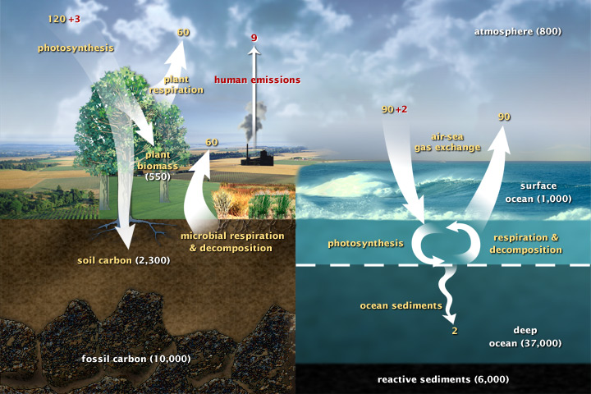
Carbon Cycle
Notes:
So this is how biogeochemists and chemical oceanographers frame these common biogeochemical cycles. This is a simplified view of the global carbon cycle which we will go into more detail in a moment. But you can see that these are values in white which represent the amount of carbon in that reservoir. There is 1000 Gigatonnes stored in the upper ocean, 37x that stored in the deep ocean and the yellow values represent fluxes of amount of carbon in and out of these reservoirs. And this type of schematic is called a box model.

Slide 5

Box Model
If the amount of water isn’t changing over time
Sources = Sinks
Shower
2 gallons of water a min
5 gallons of water
Drain
?
Notes:
The general idea with a box model is that you can constrain an elemental cycle by accounting for the amount of the element in each reservoir and the flux in and out. We have this crazy notion that because of earth’s long geological history the concentration of each element should be a steady state overtime. So we can do some quick algebra based on calculus and solve for unknown fluxes or unknown processes. Here I walk you through a simplified example. Lets say we have a bathtub and some naughty, bored children at home trying to entertain themselves. The water level in the bathtub stays constant. The faucet is on full blast. The plug has been pulled and water is draining. For the water level to stay the same the input must equal the output. Let’s say the shower is now turned on half way. Well we think half way. These are studious kids and they want to know if half of the input is really due to the shower and half due to the faucet The rate at which water is discharged is the same. We take a 1 gallon bucket and note that it takes X mins to fill therefore we can deduce that yes, it is really on half way. So that is essentially what is going on here.

Slide 6
Box Model
If the amount of water isn’t changing over time
Sources = Sinks
Faucet
?
Shower
?
5 gallons of water
Drain
2 gallons of water a min
Faucet + Shower = Drain
Notes:
The general idea with a box model is that you can constrain an elemental cycle by accounting for the amount of the element in each reservoir and the flux in and out. We have this crazy notion that because of earth’s long geological history the concentration of each element should be a steady state overtime. So we can do some quick algebra based on calculus and solve for unknown fluxes or unknown processes. Here I walk you through a simplified example. Lets say we have a bathtub and some naughty, bored children at home trying to entertain themselves. The water level in the bathtub stays constant. The faucet is on full blast. The plug has been pulled and water is draining. For the water level to stay the same the input must equal the output. Let’s say the shower is now turned on half way. Well we think half way. These are studious kids and they want to know if half of the input is really due to the shower and half due to the faucet The rate at which water is discharged is the same. We take a 1 gallon bucket and note that it takes X mins to fill therefore we can deduce that yes, it is really on half way. So that is essentially what is going on here.

Slide 7
Carbon Cycle
Notes:
The surface ocean is our bathtub. Carbon is our ‘water’. We assume that the conc. Is not changing over time. So we can add up all the inputs and estimate the outputs.

Slide 8
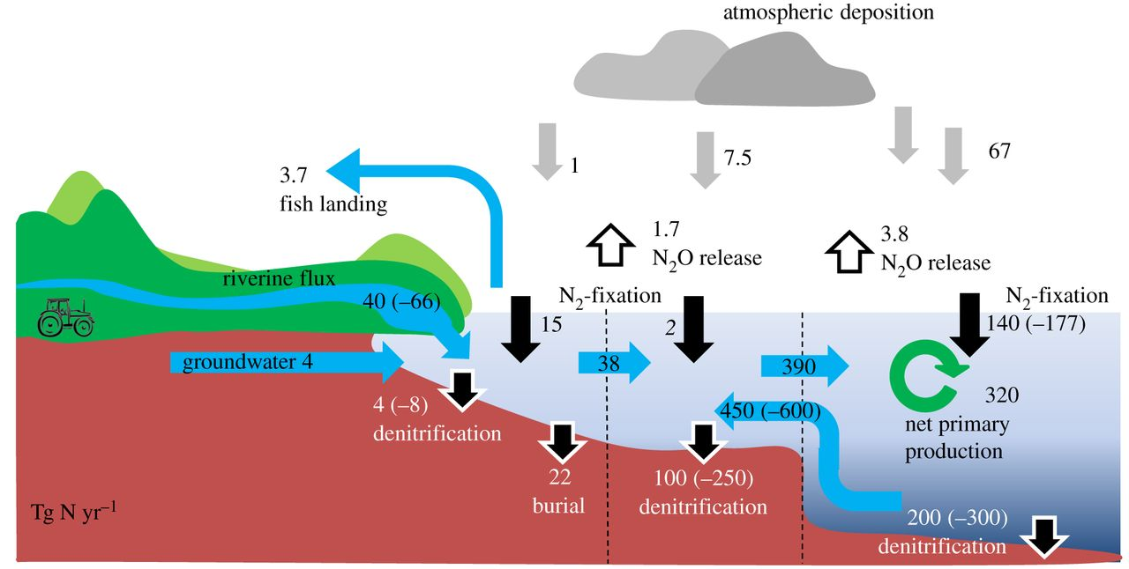
Nitrogen Cycle
Notes:
So we can constrain other important BGC cycles this way. Here is the global Nitrogen cycle.

Slide 9
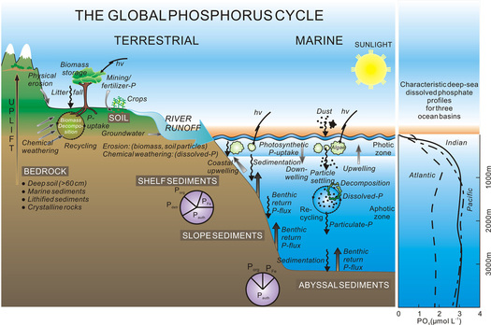
Phosphorus Cycle
Matthew Greer and Robby Voth
Notes:
The global phosphorus cycle

Slide 10
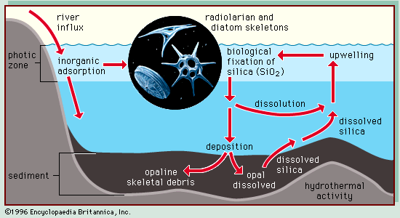
Silica Cycle
Notes:
The oceaninc silica cycle

Slide 11
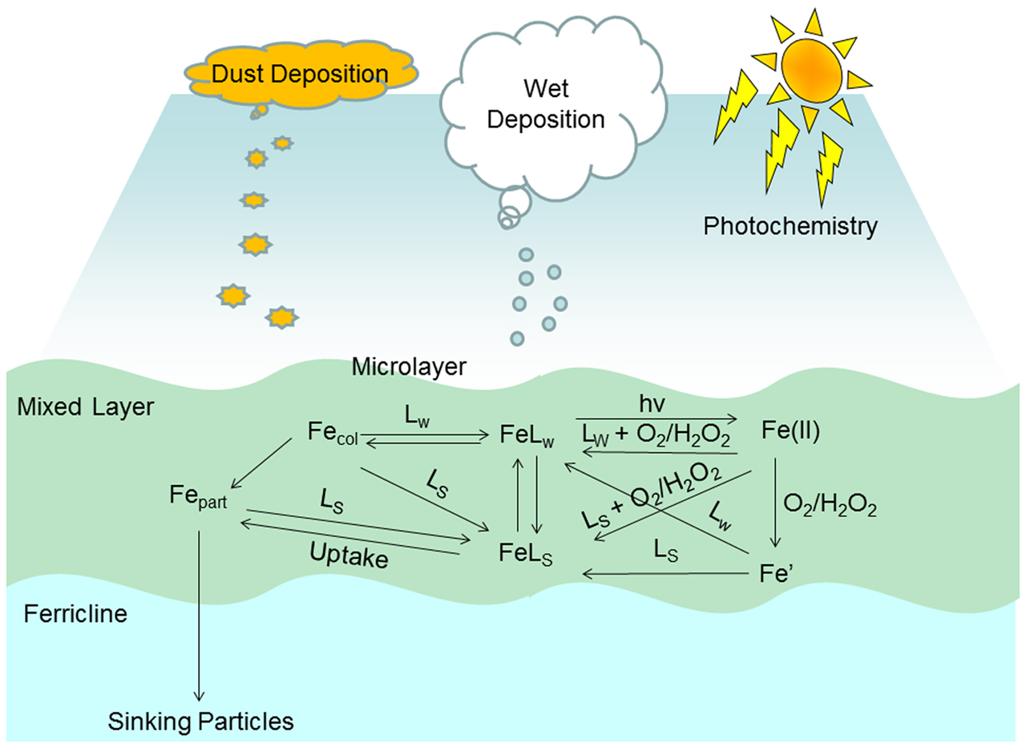
Iron (Fe) Cycle
Notes:
The oceanic iron cycle. So the box model is a very basic way biogeochemists and chemical oceanographers look at elemental cycling. Of course our field has advanced far past this and not we are interested in the nitty gritty details within reservoirs. But I won’t spend much time on those types of things today.

Slide 12
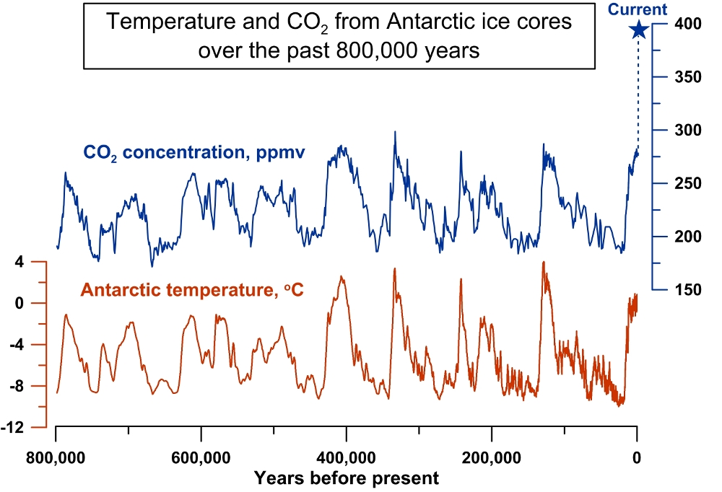
Notes:
So this talk will be anchored by the carbon cycle. In the prominent text box used in Chemical Oceanography it actually states that “carbon drives the bus” I’m not sure if the authors were referring to the fact that life is carbon based on this planet but I think they were referring to the importance of carbon dioxide in global climate. Here you can see CO2 concentrations and temperature for Antarctic ice cores from the past 800,000 years. And the temp is in lockstep with CO2 concentration. With CO2 oscillation between 180 and 280 ppm. And temp between -8 and 3 deg C. Ah but humans! Since the industrial revolution which began in the 200 yrs ago we have pumped vasts amounts of CO2 into the atm by burning fossil fuels. Today there is 408 ppm CO2 in the atmosphere, nearly a 100% increase from what we have seen in the past and added in such a short period of time this graph doesn’t really do it justice.

Slide 13
The Ocean Absorbs CO₂
Notes:
Well where does this carbon end up? Here we have 9 GT of carbon being admitted into the atm annually. 3 GT is taken up by the terrestrial biosphere. And 2 GT is taken up by the ocean although I should say there is some wiggle room around these numbers which I show you later in the talk. My main point with this slide is that the ocean plays an important role in removing the vasts amounts of CO2 that we are emitting in the atm via fossil fuel burning. I also wanted to draw attention to the difference in units here as to not confuse anyone. This is 800 GT C in the atmospheric reservoir. If you account for the volume of the atm then we get to 408 ppm..

Slide 14
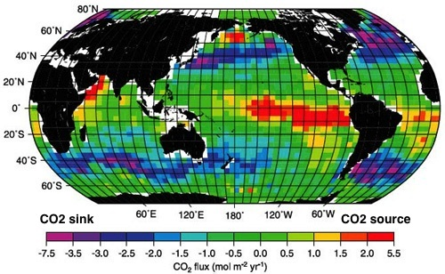
CO₂ Flux In and Out of the Ocean
IPCC 2007
Notes:
Here is a satellite image showing CO2 flux into an out of the ocean. It is not uniform geographically. We have regions where CO2 is absorbed into the ocean and regions where CO2 is degassed out of the ocean. But when we add up all these pixels the net is a 2 GT flux into the ocean. This phenomena is driven about 30% by temperature and about 70% by biology. Henry’s law is a the center of both the temperature driven effects and the biological.

Slide 15
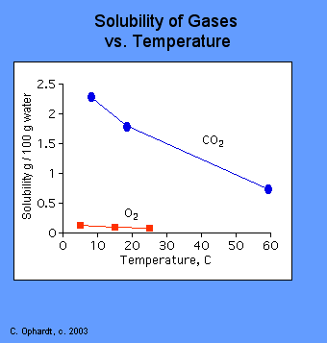
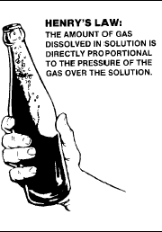
Henry’s Law
Cold water absorbs more CO2
Warm water absorbs less CO2
Notes:
So Henry’s law states that the amount of gas dissolved in solution is directly proportional to the pressure of the gas over the solution. An example is a soda. Soda is carbonated, pressure is used to add CO2 to the drink giving it is fizzy quality. What happens if you leave an open soda out for two hours? You come back and it is flat, The CO2 dissolved in the soda has equilibrated with the atmosphere and outgassed. This occurs quicker if it is warm outside verses if it cold. The lower the temperature the more gas that can be dissolved.

Slide 16
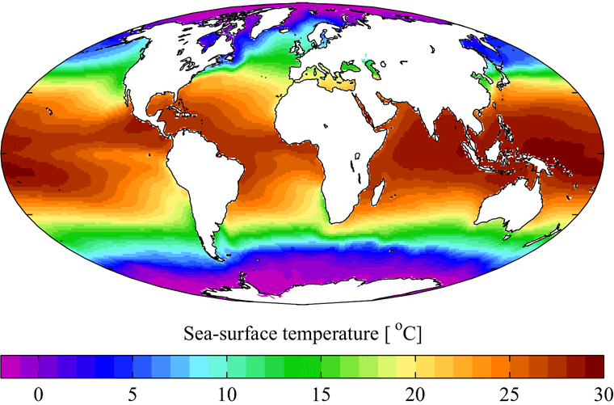
CO₂ Flux In and Out of the Ocean
IPCC 2007
World Ocean Atlas 2001
Notes:
So why isn’t the CO2 flux map directly related with temperature with polar regions being pink and dark blue? Well this is mostly due to primary productivity or photosynthesis in the surface ocean

Slide 17
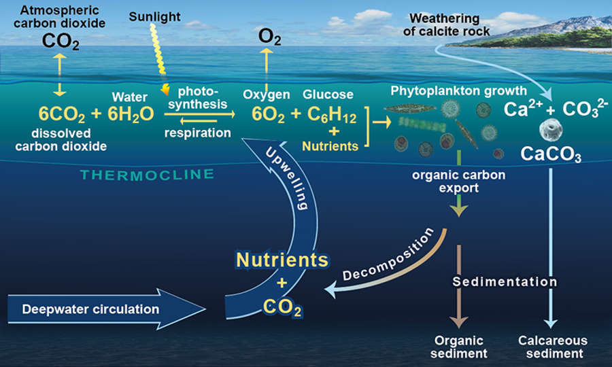
Photosynthesis drives CO₂ into Ocean
Notes:
I assume most of you are familiar with photosynthesis. Like plants on land, phytoplankton in the ocean use sunlight to take up CO2 and water and produce oxygen and sugars which are turned into cellular components building the phytoplankton biomass. Photosynthesis by phytoplankton takes CO2 out of the surface ocean, creating a disequilibrium between the atm and ocean which drives CO2 into the ocean. We can see

Slide 18
CO₂ Flux In and Out of the Ocean
IPCC 2007
World Ocean Atlas 2001
Ward and Follows 2016
Notes:
So why isn’t the CO2 flux map directly related with temperature with polar regions being pink and dark blue? Well this is mostly due to primary productivity or photosynthesis in the surface ocean

Slide 19
The Ocean Absorbs CO₂
Notes:
So you’ll remember that photosynthesis within the ocean causes 92 GT a year to be absorbed by the ocean but the majority of this, 90GT a year is outgassed. How does this happen?

Slide 20
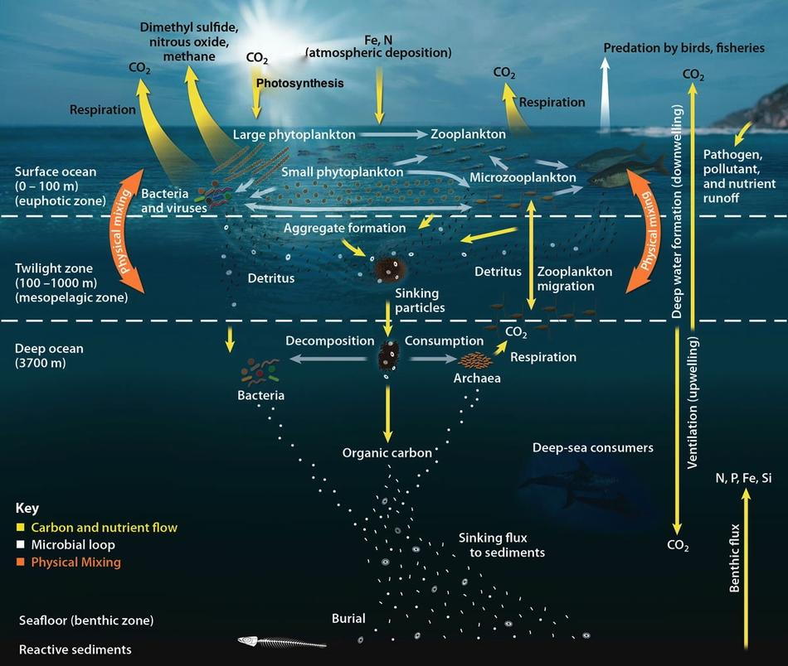
Biological Carbon Pump
Notes:
Well it is due to a complex set of interactions that involve many other marine microbes. When these phytoplankton in the surface ocean die either due to nutrient limitation, grazing, or viral infection, the carbon in their bodies begins to make its way to depth in the form of sinking particles, sometimes called marine snow, sometimes called phytodetritus, sometimes call POM or POC. Or in the form of fecal pellets. Bacteria colonize this organic matter and respire it, turning it back into CO2. This CO2 can be brought back to the surface ocean where it can exchange with atmosphere, and the majority of this CO2 does make its way back to the surface accounting for 90 GT that is released back into the atm. But 2 GT a year makes it deep enough in the ocean that it is sequestered for thousands of years or buried in the ocean sediments. So we are going to delve into these different categories of marine microbes Starting with the phytoplankton.

Slide 21
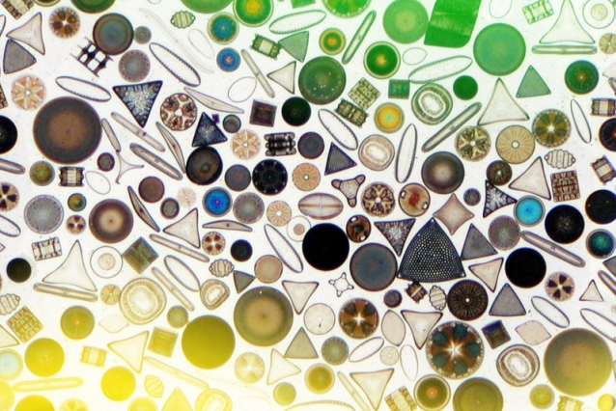
Phytoplankton-Diatoms
Notes:
These are diatoms. Eukaryotic phytoplankton meaning that they have organelles bound by membranes, a distinct nucleus, and diploid DNA. They are housed in silica frustules, essentially glass houses. Because of the biomineral that they are associated with, these frustules and their size 2 to 200μm. They sink pretty fast and are considered major contributors to export flux. Representing on 20% of primary productivity but 60% of carbon export. They also make really cool signaling molecules which I won’t go into today but that is what I did my doctoral work. So diatoms have a special place in my heart.

Slide 22
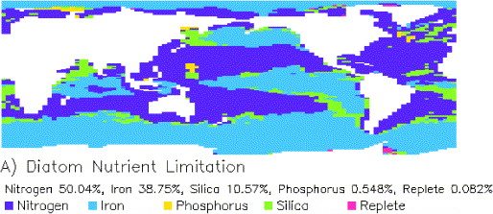
Nutrient Limitation of Phytoplankton
Moore et al., 2001
Notes:
I just like to take a moment and note that phytoplankton, like plants require nutrients to grow. Different phytoplankton have different nutritional needs. Here I am showing which nutrient is most limiting for diatoms globally. Iron and nitrogen are the most limiting. Iron is particularly hard to come by in marine environments relying on atmospheric deposition from dust. Most other phytoplankton are limited by silica but as I mentioned diatoms make their tests out of silica so there are regions where Si is limiting. So this demonstrates how the global carbon cycle is linked to other elemental cycles.

Slide 23
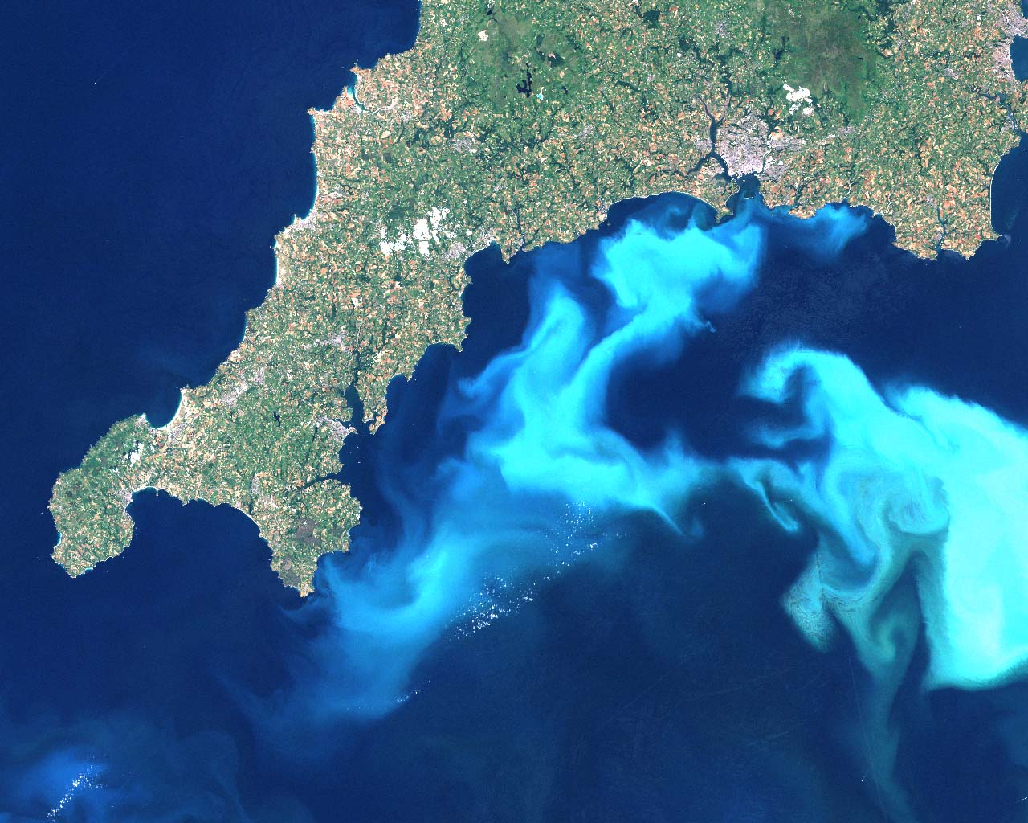
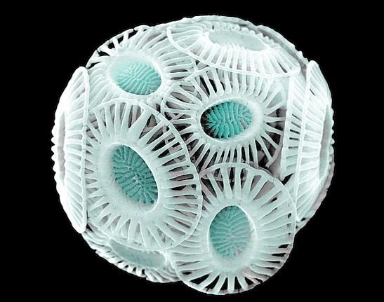
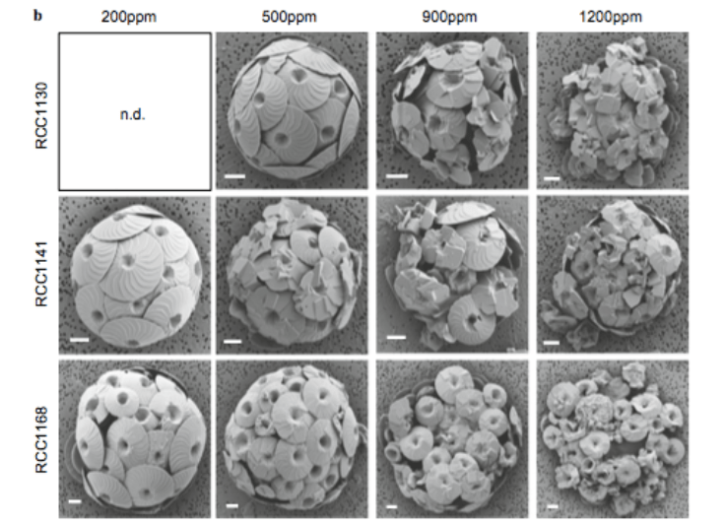
Phytoplankton-Coccolithophores
Diner et al (2015)
Notes:
Another large phytoplankton are coccolithophores. The are eukaryotic phytoplankton like diatoms. However, instead of silica the biomineral associated with coccolithophores is CaCO3. You can see here in the SEM of Emiliana huxleyi, the cells are covered with CaCO3 liths. The bright white of the CaCO3 makes these blooms visable from space. People call it milky seas. So having a heavy biomineral associated with them these phytoplankton sink pretty fast too contributing significantly to export flux. An interesting side note about coccolithophores is their CaCO3 liths makes they sensitive to ocean acidification. Because the CO2 conc of the atm is increasing, more CO2 is being dissolved in ocean, which leads to ocean becoming more acidic. This is what happens to coccolithophores when they are grown in water equilibrated with higher CO2 concentrations. 200pm is pre-industrial. We are closing in on 500ppm. And while 900ppm might seem really high, I wouldn’t put it past us. So there are some interesting negative feedback loops that could be initated as we humans alter the natural global carbon cycle.

Slide 24
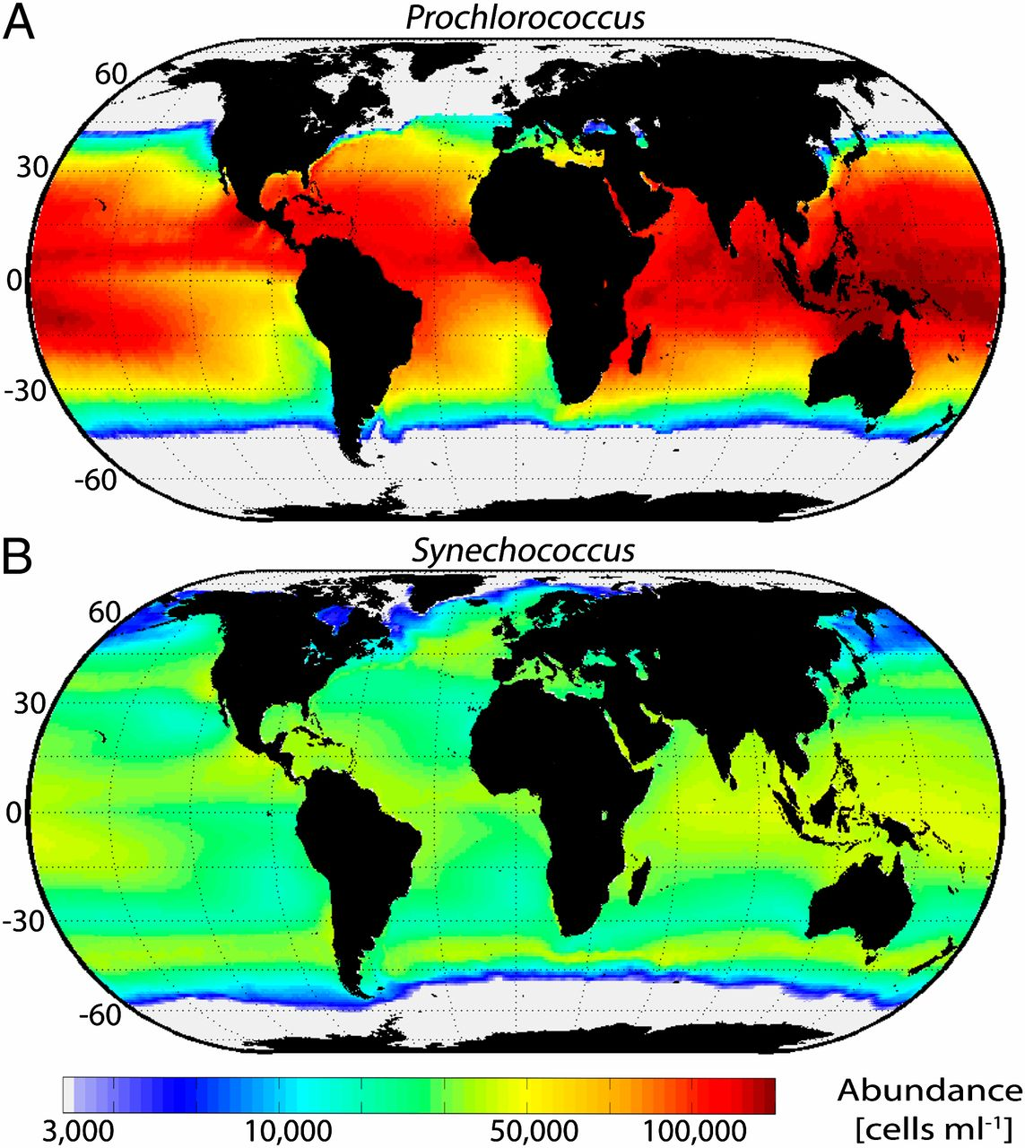
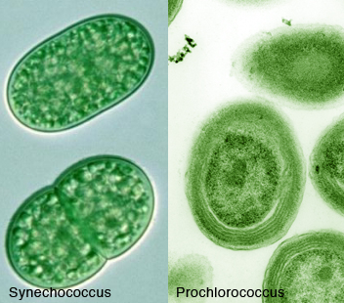
Phytoplankton-Cyanobacteria
Flobaum et al. (2013)
Notes:
Big phytoplankton get a lot of attention because they are pretty and they sink quickly but small cyanobacteria are really the work horses of ocean accounting for 25% of annual primary productivity. Cyanos like these were responsible for the oxygenation of the earth to begin with. Prochlorococcus is the most abundant photosynthetic organism in the ocean at about 100,000 cells per mil and Synechococcus is about half that. Even though they aren’t big you do find them in sinking particles. It is thought to be because marine aggregates are sticky and the numerous cyanos get trapped in there. These also serve as food for grazers which we will touch on in a moment, helping transfer carbon up the food web and away from

Slide 25
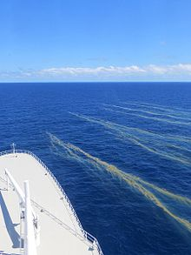
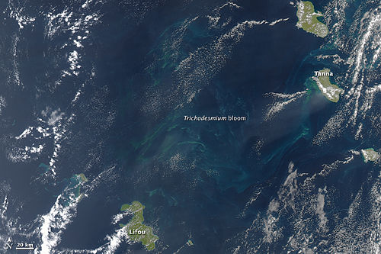
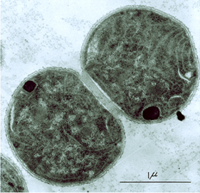
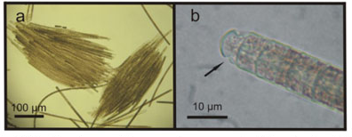
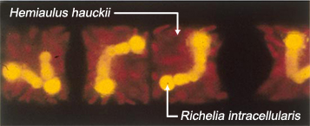
Phytoplankton-Cyanobacteria
Trichodesmium sp.
Diazotrophs- N₂ fixers
Crocosphaera sp.
NASA
Zehr (JGI)
Proença et al. (2009)
Yeung (UCLA)
Notes:
Other really cool cyanos include the diazotrophs which means nitrogen fixers. So we know N is a major limiting nutrient for phytoplankton in the ocean. These cyanos can take N2 straight out of the air and turn it into bioavailable forms. Isn’t life amazing. And diazotrophs come in a number of different flavors. We have trichodesmium which are large filamentous cells. They call them saw-dust of the sea. Here you can see a tricho bloom from space. And this is what they look like from the ship. In the late 2000s they were kind of the Rockstars in marine microbiology. We have crocosphaera which are pretty small but they exude organic matter as they bloom which can aggregate together and sink. So even little guys can be important for export. Not to mention that they supply a limiting nutrient to other phytoplankton in the environment. We also have cyanos that live endosymbionts of diatoms, so inside of diatoms fixing N2 just for the diatoms. And we’ve talked about diatoms being big phytos that sink fast. We when they are coupled with their own personal supply of N this is intensified.

Slide 26
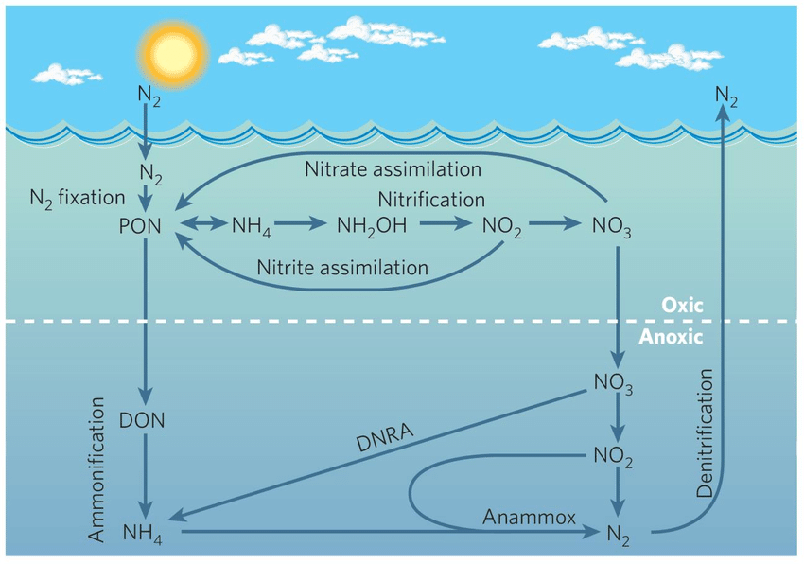
Oceanic Nitrogen Cycle
Arrigo et al. (2005)

Slide 27
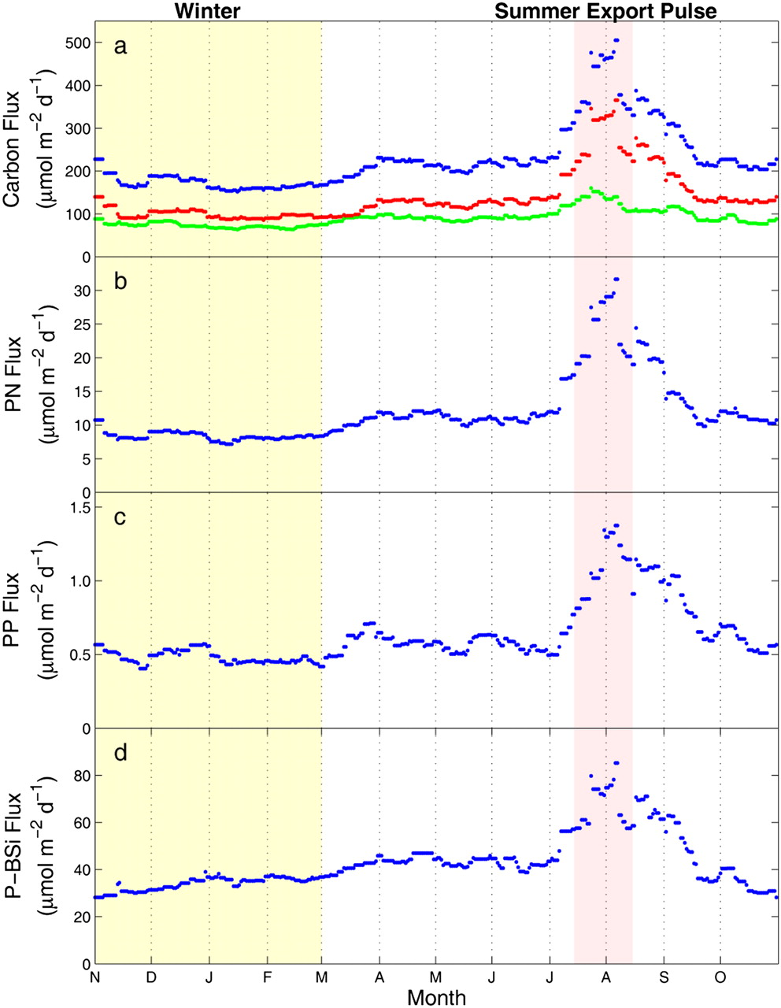
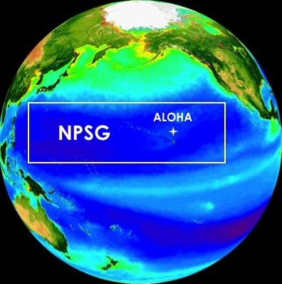
Large Carbon Export Event Linked to Diatom-Diazotroph Association
Summer Export Pulse (SEP)
between July 15th and Aug 15th
20% of annual carbon export
Karl et al. (2012)
Notes:
Station ALOHA the site of the Hawaii Ocean Time Series. Where researchers have been visiting the same spot in the ocean since 1988 measuring a range of parameters. And one of the products of this study is the discovery of the Summer Export Pulse. So here is annual carbon flux at Station Aloha averaged over 13 years. We see fairly low export during winter and little bump in the spring and then this very large pulse in late summer.
Termed the SEP it accounts for 20% of the annual carbon export at station ALOHA an occurs between July 15- Aug 15. Here you see bSi export to 4000m also reflecting the SEP suggesting that this is due to Diatoms. Using a variety of techniques that we can get into afterwards if you like, scientists have determined that these diatom-diazotroph associations. So again we can see how the C, N and Si cycles are tied together through the activity of marine microbes.

Slide 28
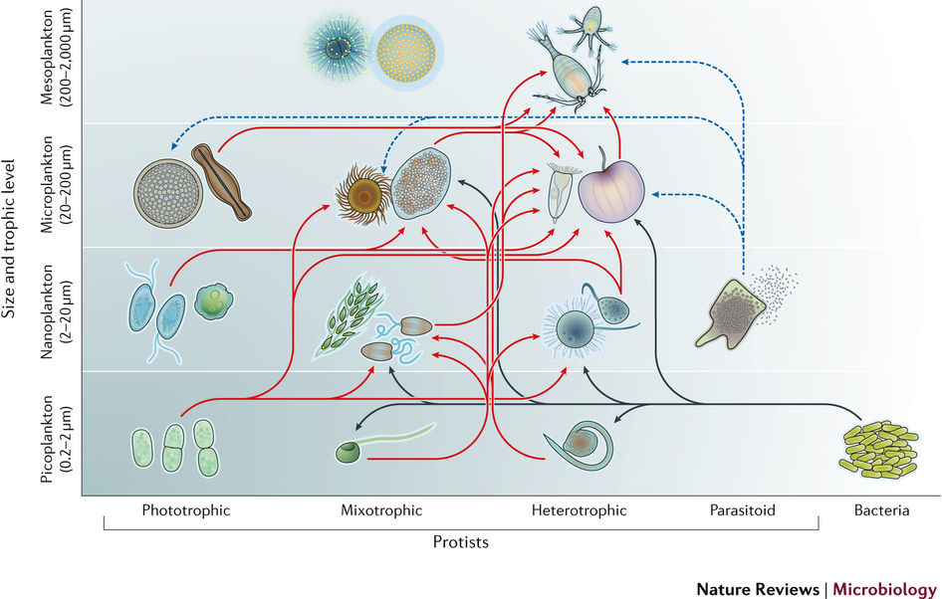
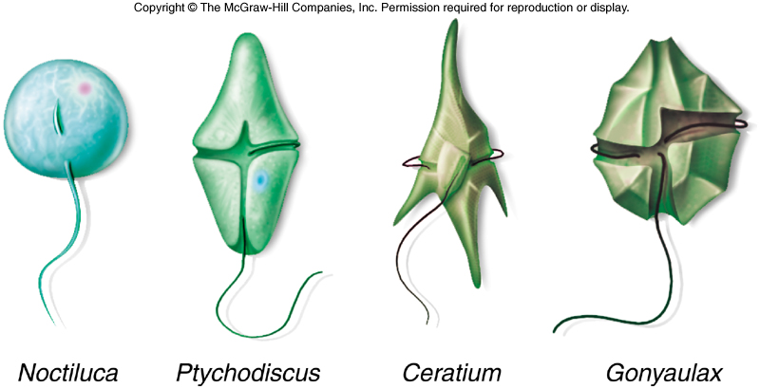
Phytoplankton- Dinoflagellates ?
Caron et al (2016)
Notes:
So we’ve covered these larger phyto like diatoms and tricho and these smaller cyanos that sometimes live with these guys. There also also photosynthetic dinoflagellates. These guys have a theca and flagella. They are a little smaller than the diatoms. But the dinoflagellates. They are some interesting creatures they can also be mixotrophs. Noctiluca is a heterotroph. Ptychodiscus and Gonyaulx are phototrophs and as HABs. Ceratium is a mixotroph

Slide 29
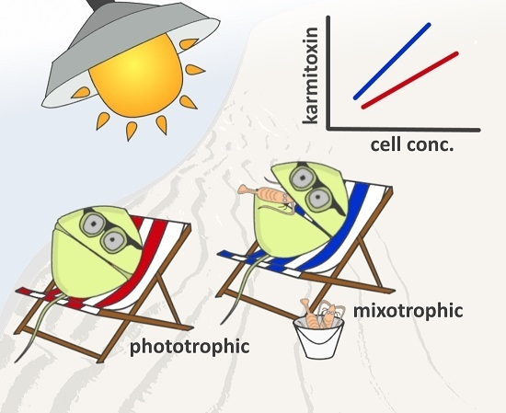
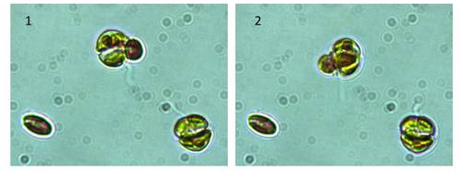
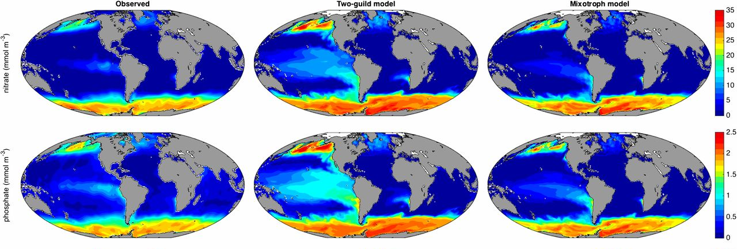
Phytoplankton-Mixotrophic Dinoflagellates
Photo credit: Albert Calbet
Ward and Follows (2016)
Notes:
So mixotrophs can photosynthesize and graze. Here is a photo of Karalodinum a mixotrophic dinoflagellate grazing on ________________. How crazy is that. They can fix carbon and respire it back. And this is something that we are only just beginning to understand the importance of. There was this really great paper published two years ago that compared two different models to ocean observations. In one model the scientist used a typical two-guide set-up where you have phototrophs and heterotrophs as separate inputs. And in another model they had phototrophs, heterotrophs, and added this peculiar mixotrophic behavior. So here we are looking at ocean observations of N and P concentrations to the two-guid and the mixotrophic models. Low and behold adding mixotrophs to the models yielded results that looked more like what we actually observe.

Slide 30
Biological Carbon Pump
Notes:
So I’ve alluded to this several times. Phytoplankton eventually become sinking particles. Either because the die due to nutrient stress and form aggregates which sink. This is considered a bottom up mechaisms of phytoplankton mortality. Or they could die due to top down mechanisms which would be viral infection (which I touch on later) or mortality due to grazing which will eventually add to sinking particles and export. Grazer are often split up by size, Microzooplankton and mesozooplankton.

Slide 31
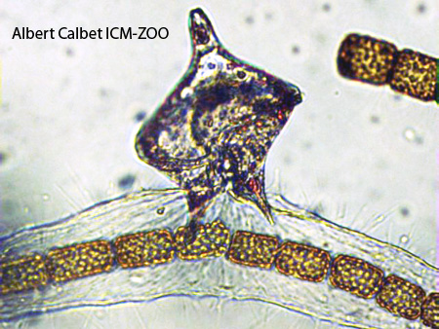
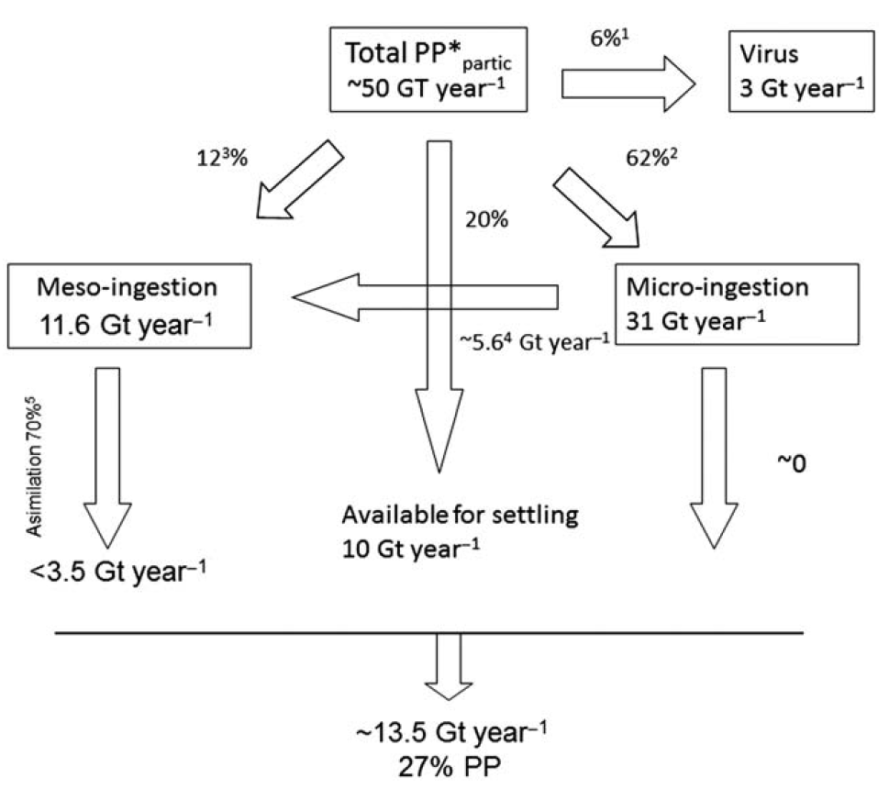
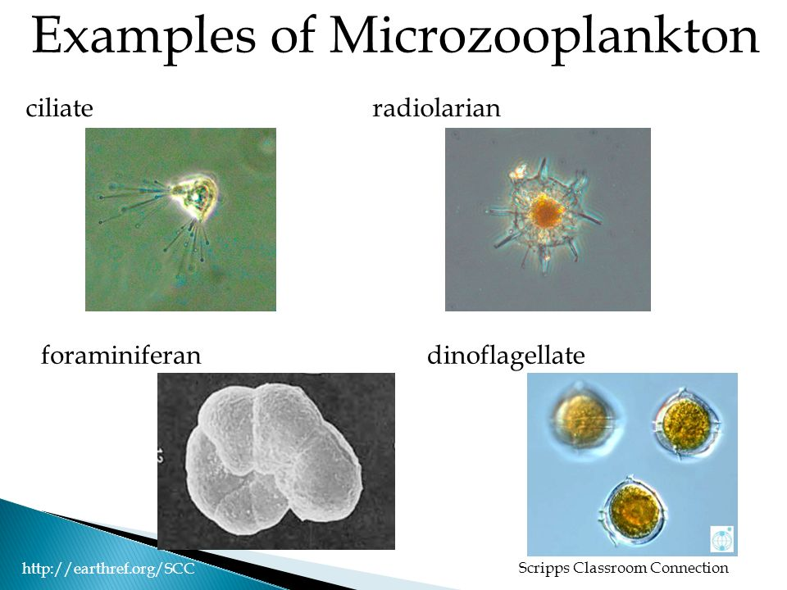
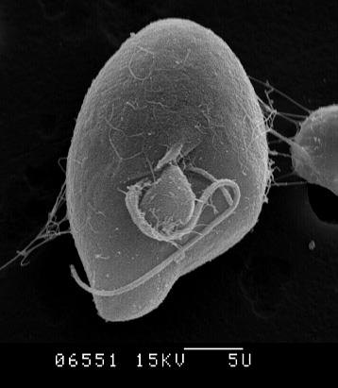
Microzooplankton grazing: important loss term for primary productivity
Forams
Cilliates
Radiolarians
Dinoflagellates
Schmoker et al. (2013)
Notes:
Lets start with microzooplankton. So these are protists like ciliates, radiolarians, forams, and dinoflagellates. Here you can see a Protoperidium dinoflagellate eating a chain forming diatom. Microzooplankton are an important loss term for primary productivity in the ocean which wasn’t really recognized until 2004 for so.
Here is a diagram depicting the flow of phytoplankton carbon through the biological pump. Microzooplankton account for 62% of annual primary productivity

Slide 32
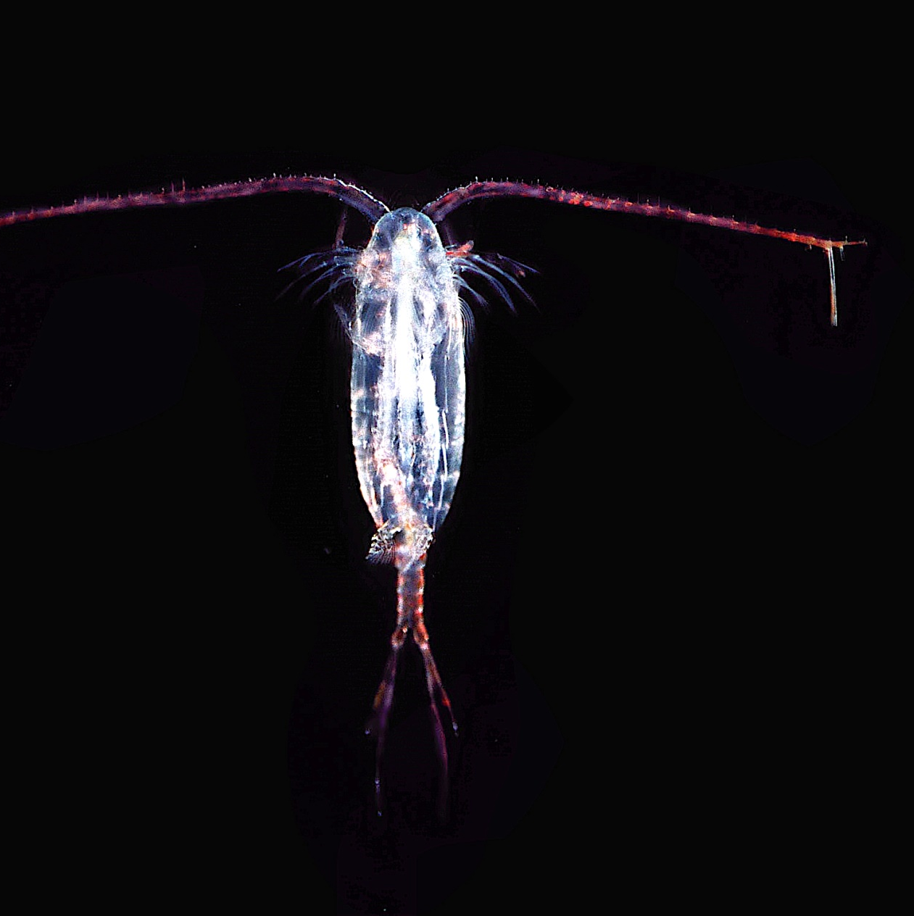

Microzooplankton grazing: important loss term for primary productivity
Schmoker et al. (2013)
Notes:
whereas mesozooplankton, like copepods account for just 12%.
However, you will notice that 30% of the carbon ingested by mesozooplankton is exported to depth whereas, microzooplankton are not thought to contribute significantly to carbon export instead they have been thought to contribute to the transfer of organic matter from the particulate pool into the dissolved pool.

Slide 33
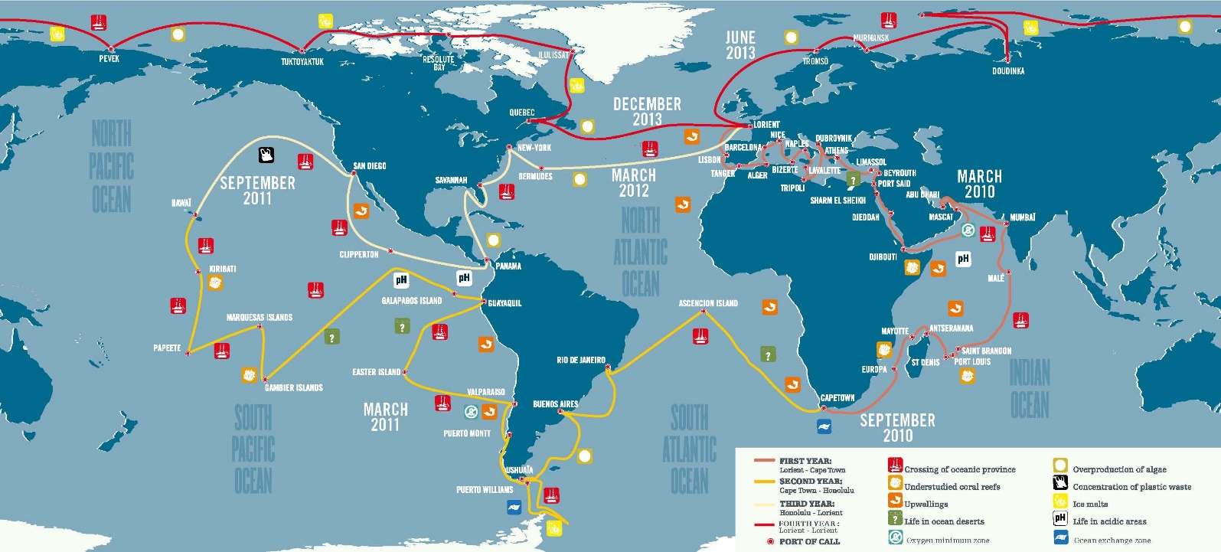
Tara Oceans - 150 m traps
Notes:
However our views on this are changing. There was this study conducted by the Europeans called Tara Oceans. Where they circumnavigated the globe sampling both the water column and sinking particles for meta’omics analysis.

Slide 34
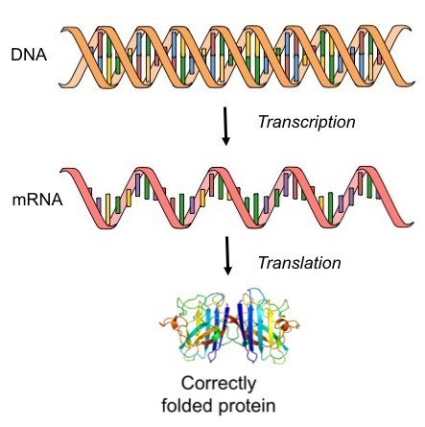
Central Dogma of Molecular Biology
Meta-Genomics
Meta-Transcriptomics
Meta-Proteomics
Notes:
So you are probably asking what is meta’omics analysis. Biology teachers are probably familiar with the central dogma of molecular biology. DNA, or genes, encode RNA which is then translated into proteins which are responsible for metabolism, building structural components of the cell, replicating the cell, you name it. So all the DNA or all the RNA can be collected from the environment and sequenced to create a meta-genome (DNA) or a meta-transcriptome (RNA). The meta-genome tells us what the organisms are in the environment and what are they genetically capable of, say N fixation or photosynthesis. The meta-transcriptome tells us what the organisms in the environment are actually trying to do, what genes to do they have turned on?

Slide 35
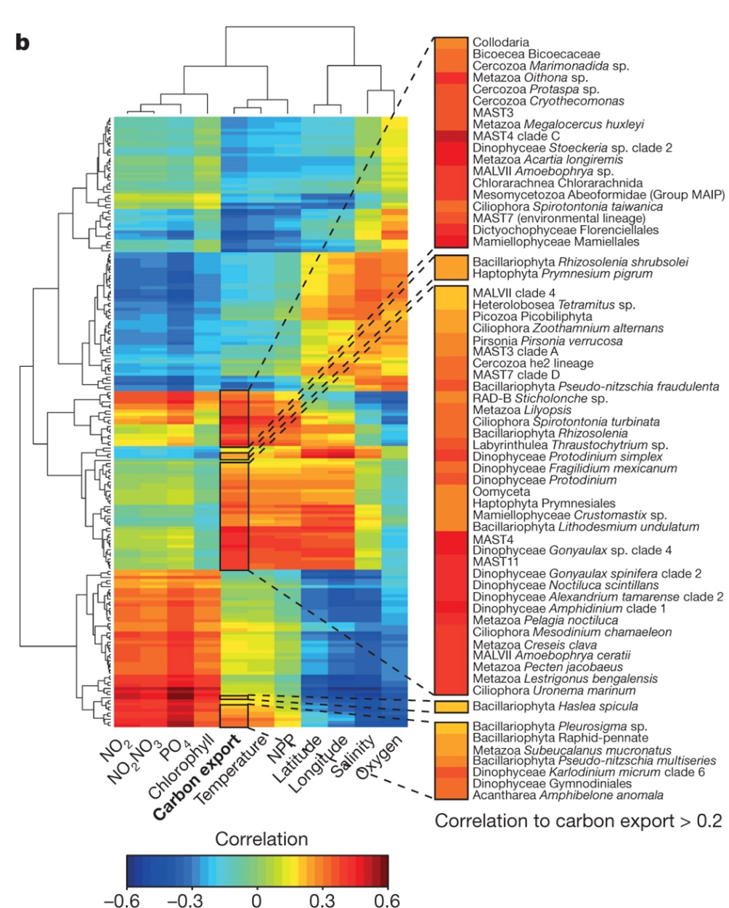
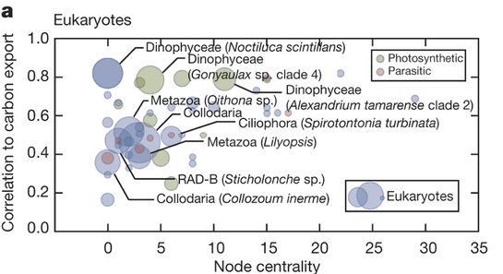
Tara Oceans - 150 m traps
Taxa correlated with carbon export:
Dinophyceae
Ciliophora
Notes:
So Tara oceans sequenced the meta-genomes the DNA of sinking particles collected all over the globe and when they found that microzooplankton were most correlated with carbon export!!! This is huge. And this is something that I’m seeing in my own work and others have found using less sophisticated techniques, so they weren’t quite taken seriously.

Slide 36
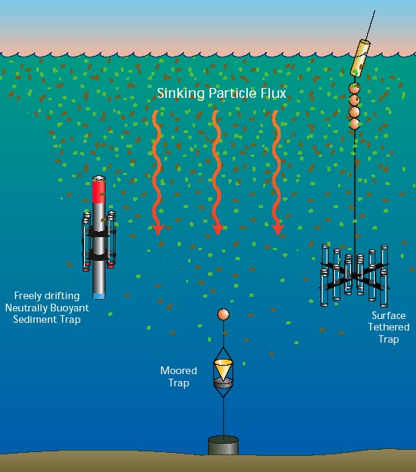
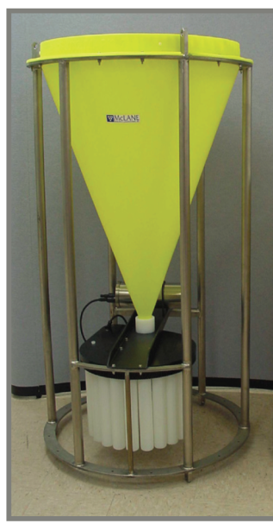
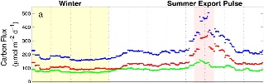
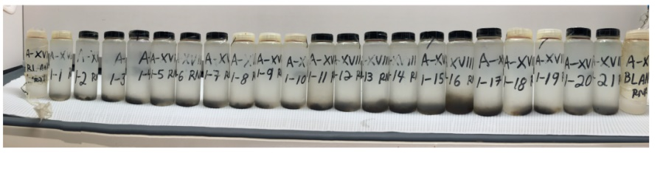
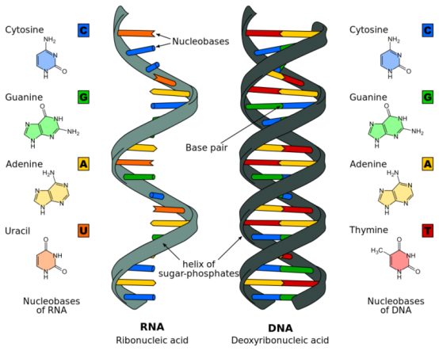
Meta-omic Time Series of Deep Sea
Particle Associated Communities
9-month deployment March to Nov. 2014- 2016
RNAlater
Geochem
2015
Meta-transcriptome
Meta-genome
RNA
DNA
2016
WHOI Graphics
2014
Notes:
So we wanted to build a meta-omic time series of the communites associated with particles reaching the deep sea. So we deployed two of these moored sediment traps at 4000m for 9 months and collected sinking particles raining down from the surface ocean in these cups which rotate roughtly every two-weeks. One trap had RNAlater in it to preserve nucleic acids. The other just has formaldehyde in it to kill whatever falls into it and is the standard trap set up use by the HOTS program to build the previous climitology. This is what the trap material looks like. This is sample from 2015 and you can see the nice little pulse there. Extract RNA and DNA from the trap material to sequence the meta-genome and meta-transciptome. Meta-genome tells you who is there. Meta-transcriptome tells you what genes are being expressed in an effort to produce proteins (central dogma), so what the microbes are trying to accomplish.

Slide 37
What is the biological source of particle flux at depth?
Meta-genome
DNA
Microzooplankton
grazers
Phytoplankton
Edwards et al (in prep)

Slide 38
Microzooplankton grazing: important loss term for primary productivity
Schmoker et al. (2013)
Notes:
So microzooplankton likely contribute more to export than we previously thought and this figure appears to be wrong.

Slide 39
Biological Carbon Pump
Notes:
So what happens to these sinking particles? Well they are colonized by bacteria.

Slide 40
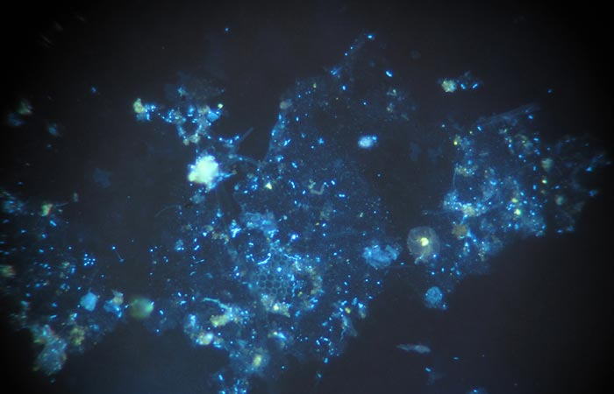
Bacteria Colonize Sinking Particles
Notes:
Here is a epifluorescent image of some particulate organic matter. The blue dots are bacteria. The green are phytoplankton, and the matrix in between is what we can TEP or transparent extracellular polymers. It is mostly organic carbon in the form of sugar polymers. Bacteria colonize this organic material as it aggregates together in the surface ocean and sinks to depth. And they respire it. Turning organic material back to CO2.

Slide 41
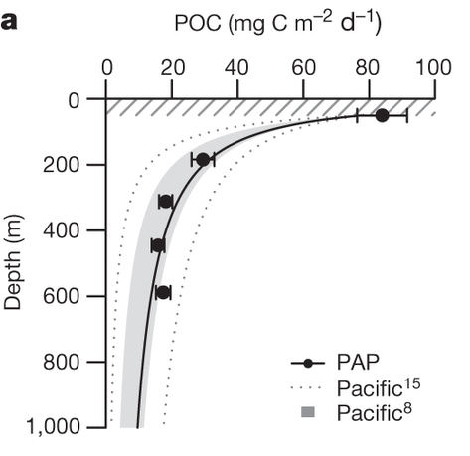

Amount of C in Sinking Particles ↓ with Depth
Notes:
And if we measure the carbon in sink particles through out the water column we see that there is less and less C as we get deeper in the ocean due to the respiration by marine bacteria. And this is why 92GT of carbon is absorbed by the ocean each year and only 2 GT makes it to the deep ocean.

Slide 42
Bacteria Colonize Sinking Particles
Notes:
These bacteria don’t just respire carbon. They also facilitate reactions in other elemental cycles

Slide 43
Oceanic Nitrogen Cycle
Arrigo et al 2005
Notes:
For example all the chemical transformations in the Oceanic N cycle outside of N2 fixation are facilitated by bacteria in the ocean.

Slide 44
Meta-omic Time Series of Deep Sea
Particle Associated Communities
9-month deployment March to Nov. 2014- 2016
RNAlater
Geochem
2015
Meta-transcriptome
Meta-genome
RNA
DNA
2016
WHOI Graphics
2014
Notes:
So we wanted to build a meta-omic time series of the communites associated with particles reaching the deep sea. So we deployed two of these moored sediment traps at 4000m for 9 months and collected sinking particles raining down from the surface ocean in these cups which rotate roughtly every two-weeks. One trap had RNAlater in it to preserve nucleic acids. The other just has formaldehyde in it to kill whatever falls into it and is the standard trap set up use by the HOTS program to build the previous climitology. This is what the trap material looks like. This is sample from 2015 and you can see the nice little pulse there. Extract RNA and DNA from the trap material to sequence the meta-genome and meta-transciptome. Meta-genome tells you who is there. Meta-transcriptome tells you what genes are being expressed in an effort to produce proteins (central dogma), so what the microbes are trying to accomplish.

Slide 45
What metabolic strategies are being employed?
Meta-transcriptome
RNA
1.6 x 10¹² reads
Edwards et al (in prep)
Notes:
Figure X. A) Percentage of eggNOG annotated meta-transcriptome belonging to each broad functional classifications: Metabolism, Information Storage and Processing, Cellular Processing and Signaling, and Poorly Characterized. B) Percentage of Metabolism transcripts functionally annotated to each specific orthologous group (OG). C) Ten most abundant transcripts in the Energy and Conversion OG.

Slide 46

Denitrification in anoxic microniches on sinking particles exported in oxic ocean?
Edwards et al (in prep)

Slide 47
Denitrification in anoxic microniches on sinking particles exported in oxic ocean?
Edwards et al (in prep)
Klawonn et al (2015)

Slide 48
Biological Carbon Pump
Notes:
Ok. So we’ve covered the entire biological carbon pump. Except viruses which only get a small feature here in the surface ocean.

Slide 49

The Viral Shunt
Notes:
Viruses are thought to participate in what we call the viral shunt. Essential viruse infect either phytoplankton or bacteria and lyse them causing Carbon that could have been exported in a particulate form to leak out into the dissolved pool. So viruses are thought to shunt carbon away from export. Viruses are most well studied in the water column But we are starting to appreciate how they might be impacting the ecosystems of sinking particles

Slide 50
Viruses in Fecal Pellets
Frada et al 2014
Notes:
So recently viruses of the coccolithophore E. hux were found in copepod fecal pellets. And these viruses were still viable.

Slide 51
Viruses on Sinking Particles
Edwards et al (in prep)
Notes:
And finally we get to some of my work. We sequenced the meta-transcriptomes of sinking particles collected in the deep ocean 4000m over a 9-month time-series. And we found that the most abundant transcripts in our dataset were from viruses. Suggesting active infection on sinking particles

Slide 52
The Viral Shunt
Notes:
So we might need another viral shunt loop over in the particulate organic matter pool.

Slide 53
Biological Carbon Pump

Slide 54
Learning Objectives
Define Biogeochemistry
Understand the Importance of Global Carbon Cycle
Describe the Roles of Marine Microbes in the Oceanic Carbon Cycle (and Connections with Other Elemental Cycles)
  Phytoplankton
  Microzooplankton
  Mesozooplankton
  Heterotrophic Bacteria
  Viruses

